Slide 1

C Programing
-----DOWNING MAN
speaker: Tao Pengcheng
Zhu Junze

Slide 2
01
Problem Statement
Analysis
02
03
Design
Contents
04
implementation
05
test

Slide 3
01
Problem Statement

Slide 4
01
The problems
Randomly generated board
Control the interface/man moving
Make the guy stop when touching
More.....

Slide 5
02
Analysis

Slide 6
02
研究意义
RESEARCH AND SIGNIFICANCE
01
mainly focused on three parts
02
03

Slide 7
02
Randomly generated board
1.We have learnt randomly generated the figures
2.We want the board appeared with the interface moving down,and interval orderly
3.We would use the console as our function,any help?

Slide 8
02
Control the interface/man moving
1.The relative motion(the bords or the whole background )
2.the man's relative motion and the control of it
3.We would use the console as our function,any help?

Slide 9
02
Make guy stop when touching
1.The cprograming could only know figures and comments
2.To judge the touching,we need the bottom of the man touch the board
3.relationship between the two former questions?

Slide 10
02
The job we have down
Tao Pengcheng
Zhu Junze
Cooperation
The menu interface
The boards function
The connection of the interfaces
The movement of the man
The “play” function
The thoughts
The arithmetic
The three main problems

Slide 11
03
Design
&
implementation

Slide 12
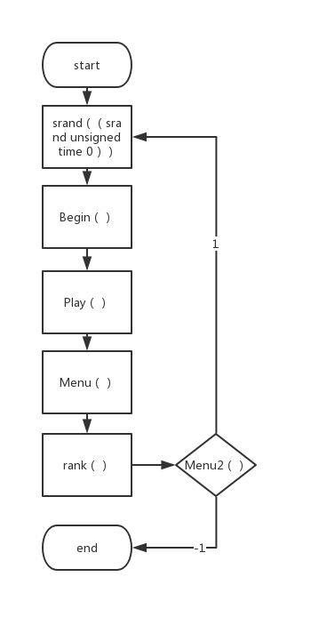
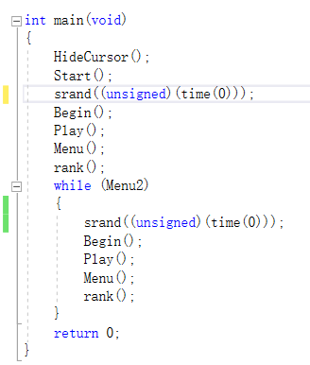
03
main interface

Slide 13
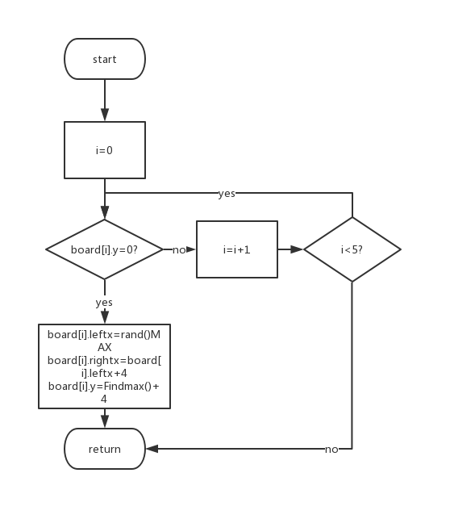
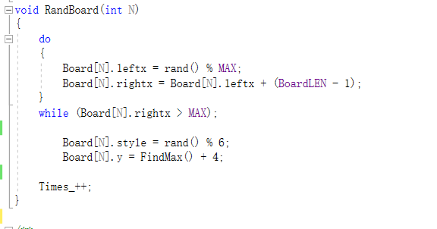
03
Rand
Board

Slide 14
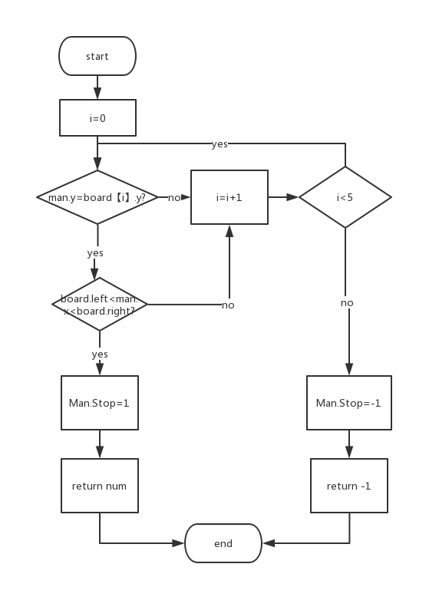
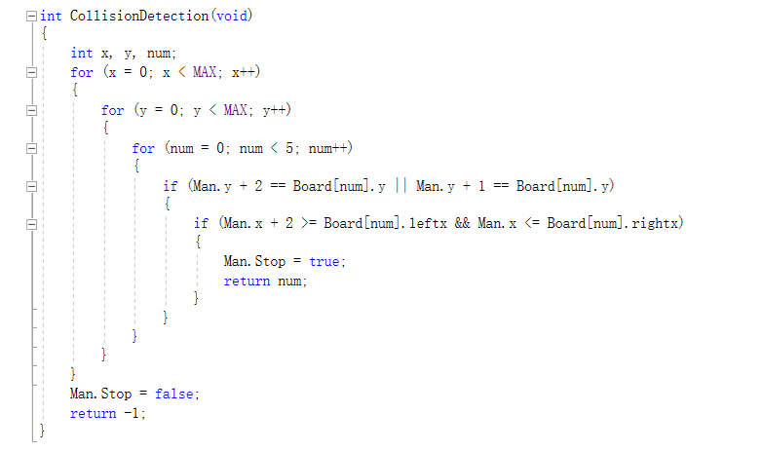
03
Collision Detection

Slide 15
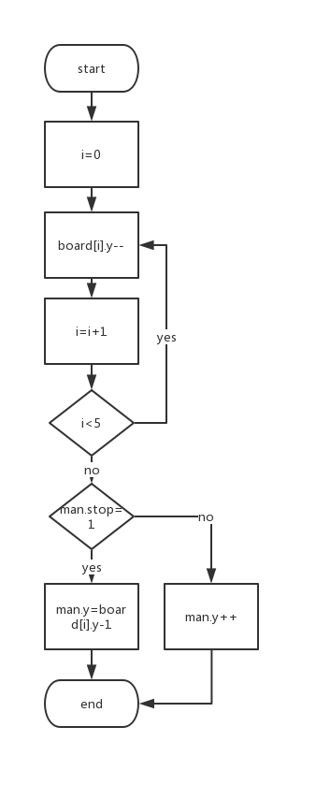
03
the boards
moving

Slide 16
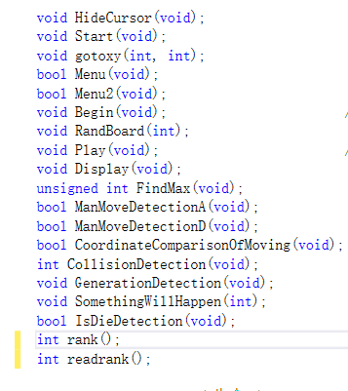
03
function ued in the game

Slide 17
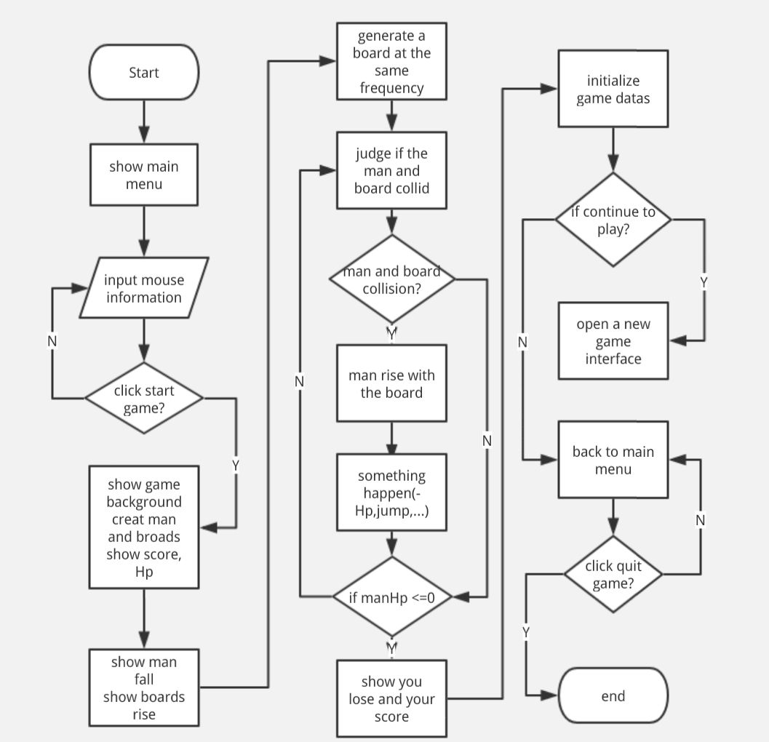
03

Slide 18
04
Test

Slide 19
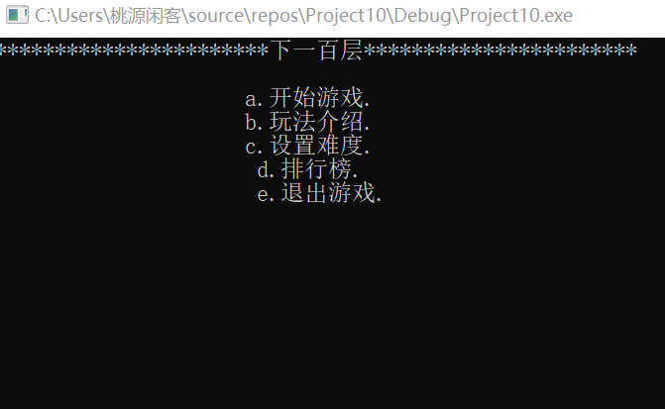
04
The Menu Interface

Slide 20
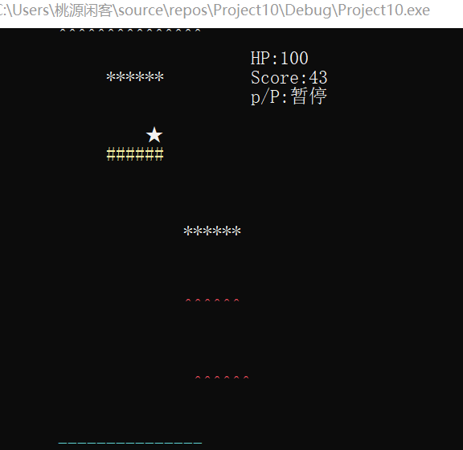
04
The Game Interface

Slide 21
THANK YOU

